Slide 1





















Lecture No 05

Slide 2



















































Slide 3

































Slide 4





























































Slide 5





























Slide 6




























































Slide 7








































Slide 8












































Slide 9




















Slide 10

































Slide 11


































Slide 12







































Slide 13







































Slide 14
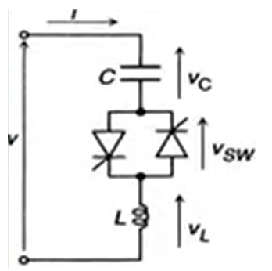




















Slide 15








































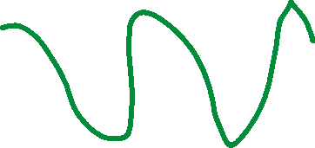






Slide 16





























































